Slide 1

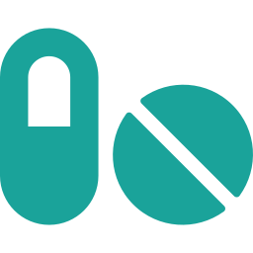
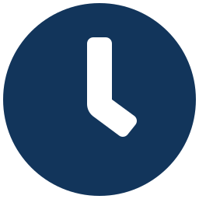
Medicine Reminder
A MERN-Stack Application to Manage Medicine Schedules
Presented by:
K.UMASHANKAR 25MVCSMRO405
Y.DASTHAGIRI 25MVCSMRO454
G.SAI CHARAN 25MVCSMR0395
M.MOHAN 25MVCSMR0410

Slide 2

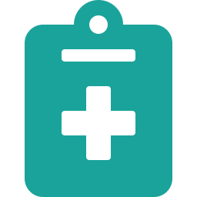
Problem Statement
The Challenge
People often forget to take medicines on time, miss doses, or lose track of start and end dates of a course.
Our Solution
Build a MERN-based Medicine Reminder that manages medicine schedules in one simple, reliable place.
2

Slide 3
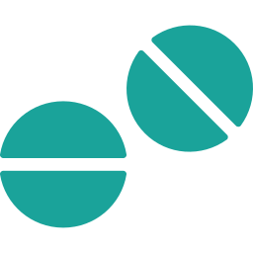


Detailed Description
Medicine
Dosage
Time
Start / End Date
Name of the medicine
Quantity per intake
When to take it
Duration of the course
Stored in MongoDB. React provides the UI, while Node.js and Express.js handle the backend APIs. The system supports adding, viewing, updating and managing records.
3

Slide 4

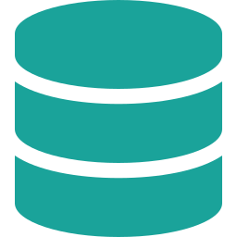
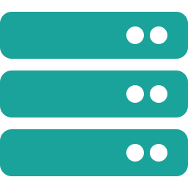



Objectives
Demonstrate MERN Stack development
Implement CRUD operations using MongoDB
Build REST APIs with Node.js and Express.js
Develop the frontend using React.js
Implement authentication and role-based access
Display project information and results clearly
4

Slide 5
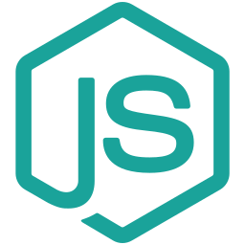

System Architecture
React.js
Node + Express
MongoDB
User Interface
REST APIs
Data Storage
5

Slide 6
CRUD Operations & REST APIs
Method | Endpoint | Purpose
POST | /api/medicines | Add a medicine
GET | /api/medicines | View all medicines
PUT | /api/medicines/:id | Update a medicine
DELETE | /api/medicines/:id | Remove a medicine
6

Slide 7

Authentication & Key Features
Secure Access
Login & registration
Role-based access (Admin / User)
Each user sees only their own medicines
Smart Reminders
Daily medicine schedule view
Dosage and time at a glance
Start / end date tracking
7

Slide 8

Conclusion
Medicine Reminder demonstrates the full MERN stack
CRUD, REST APIs and authentication working together
Helps users stay consistent with their medication

Slide 9
THANK YOU

